Slide 1
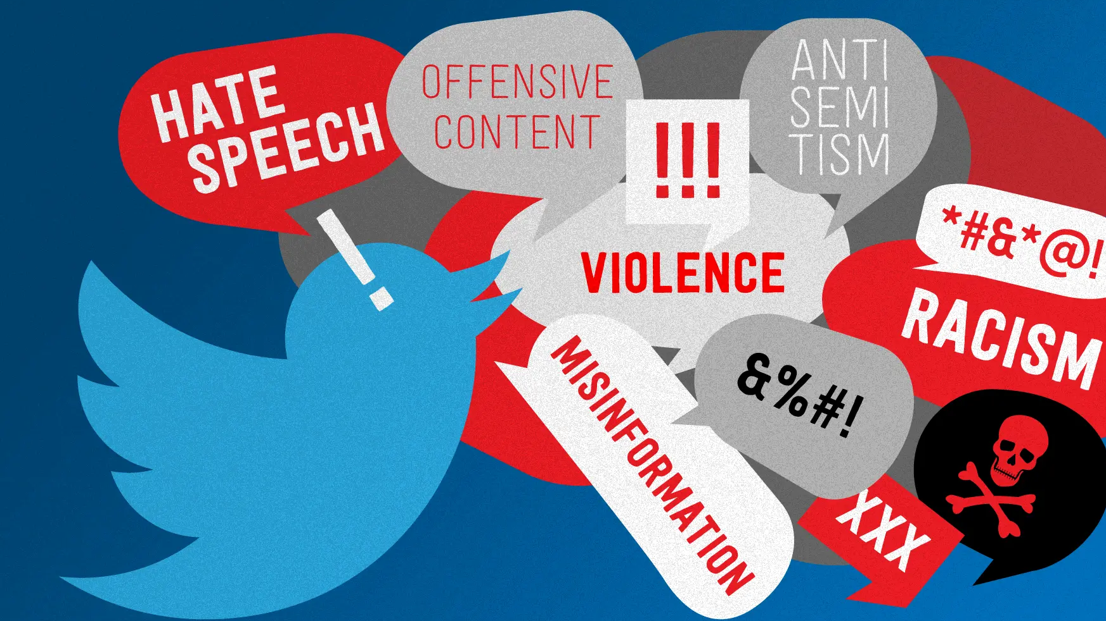
Analyzing Hate Speech Dynamics on Twitter Using Text Mining and NLP Techniques
Team Members
M K Sowmeya
Harshita Tanksali
Gughapriyaa Elango
Mohammed Huzaif Kherani

Slide 2
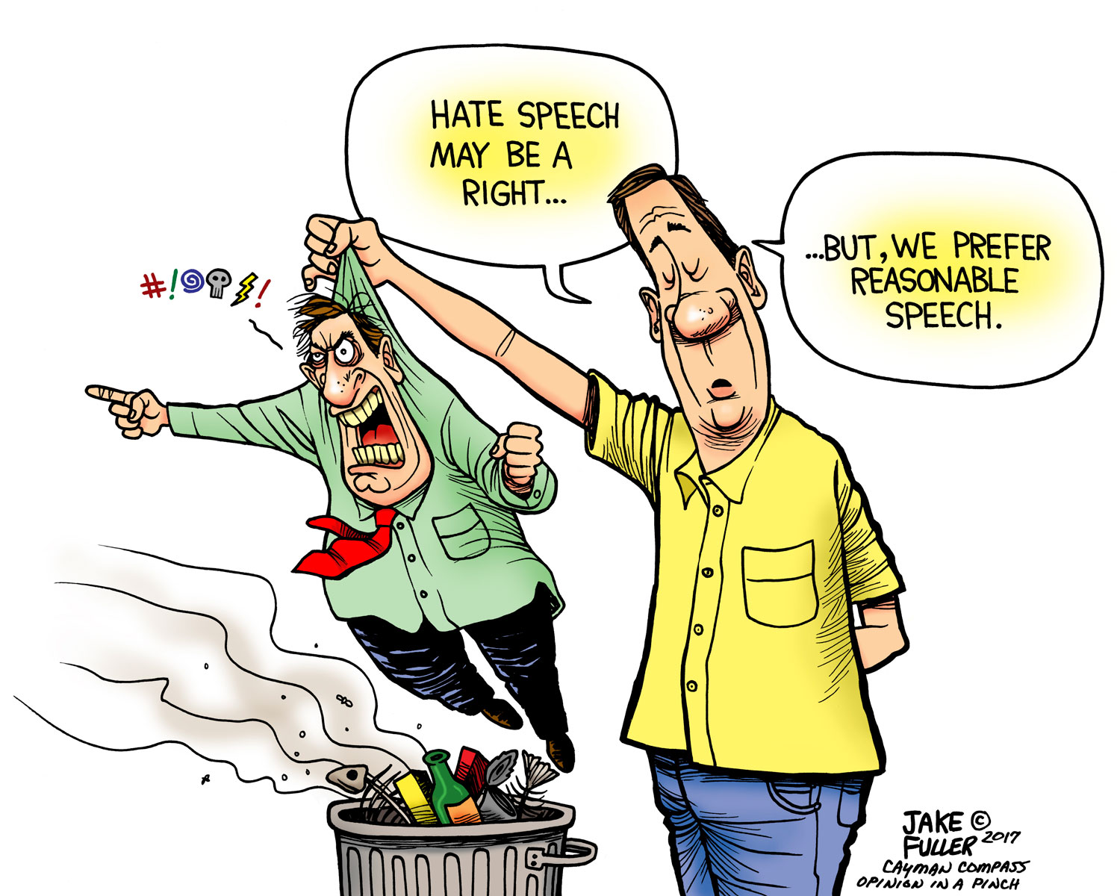
Project Overview
Addressing Online Harm: The prevalence of hate speech on social media platforms poses significant challenges to fostering a safe and inclusive online environment. This project aims to contribute to the ongoing efforts to mitigate online harm by developing an effective hate speech detection model.
User Well-being: Creating a platform that can automatically identify and flag hate speech contributes to the protection of users from harmful content, promoting a positive online experience.
Algorithmic Fairness: By leveraging state-of-the-art techniques like CNN, the project strives to enhance the fairness of hate speech classification algorithms, minimizing biases and ensuring equitable treatment across diverse user groups.
Community Engagement: Facilitating community discussions on responsible AI use, ethical considerations, and the importance of collaborative efforts in addressing online toxicity.

Slide 3
Motivation
Algorithmic Amplification:
Social media algorithms unintentionally boost hate speech by prioritizing sensational or divisive content for engagement.
DeepFakes and Manipulated Content:
The rise of deepfake technology contributes to the spread of hate speech through convincing fake videos or images.
Evasion Tactics:
Perpetrators use coded language and memes to evade automated detection, posing challenges for content moderation.
Private Messaging Platforms:
Hate speech is shifting to private messaging platforms, making it harder to monitor compared to traditional public content moderation.
Polarization and Echo Chambers:
Social media reinforces hate speech within specific communities, intensifying societal polarization.
Globalization of Hate Speech:
Social media's borderless nature allows hate speech to transcend geographical boundaries, connecting extremist online communities

Slide 4
Methodology
Data Loading and Exploration
Data Visualization
Text Preprocessing
Word Cloud Visualization
Hashtag Analysis
Topic Modeling (Latent Dirichlet Allocation - LDA)
Sentiment Analysis
Vader Sentiment Analysis
Machine Learning Models
Deploying the models
Ethics

Slide 5
Challenges Overcome
Traditional models like Mnb and SVM often struggle with capturing the contextual nuances of words.
Traditional models like Mnb and SVM often struggle with capturing the context of words. Fine-tuning and using better embeddings can enhance the models' ability to understand the context of words.
Double negatives pose a challenge for models like Mnb and SVM, as they may not inherently grasp the negation within the sentence.
Using embeddings that capture syntactic and semantic structures can aid in understanding the negation patterns within sentences
Double negatives pose a challenge for models like Mnb and SVM, as they may not inherently grasp the negation within the sentence.
Combination of fine-tuning on domain-specific data and leveraging advanced embeddings, especially contextual embeddings like BERT, can significantly improve the models' performance in handling word ambiguity

Slide 6
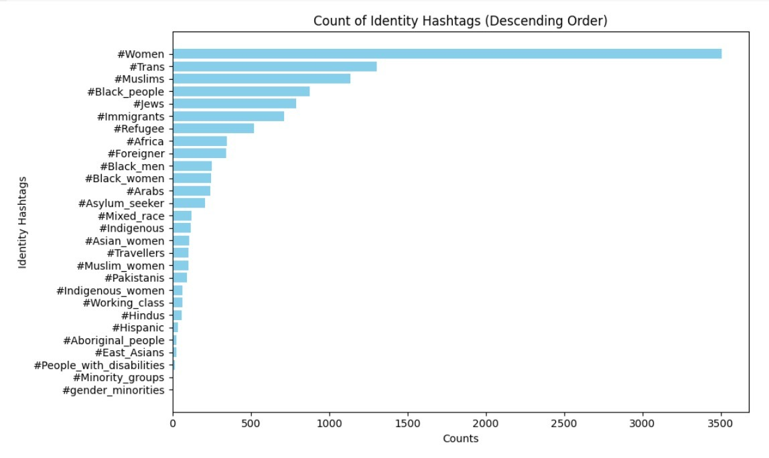
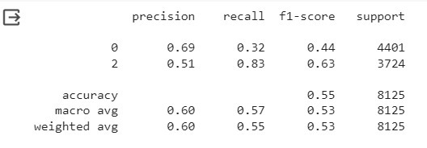
Hashtag Analysis
LOGISTIC REGRESSION MODEL USING HASTAG WORDS EMBEDDING

Slide 7
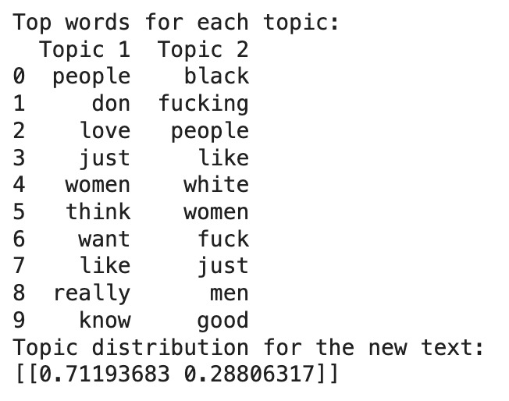
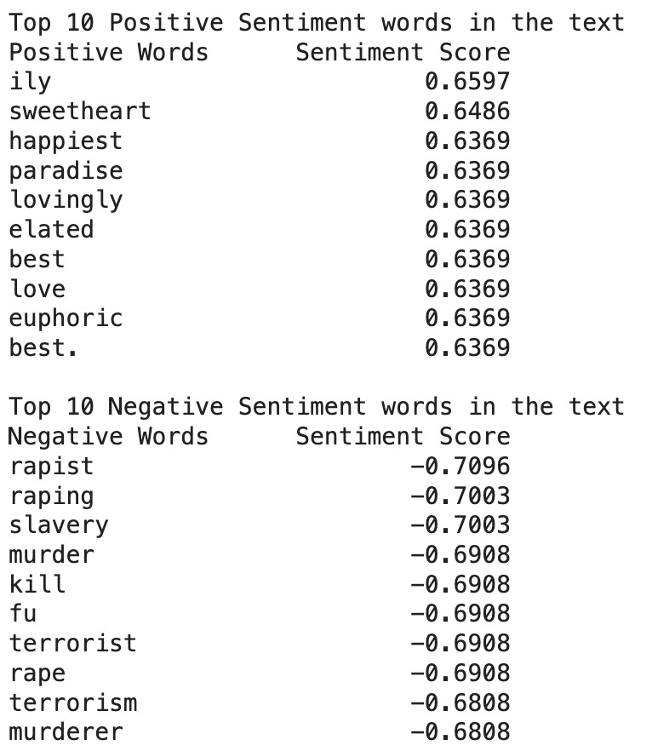
Comparative Analysis of Sentiment Words and Hate Speech Topics

Slide 8
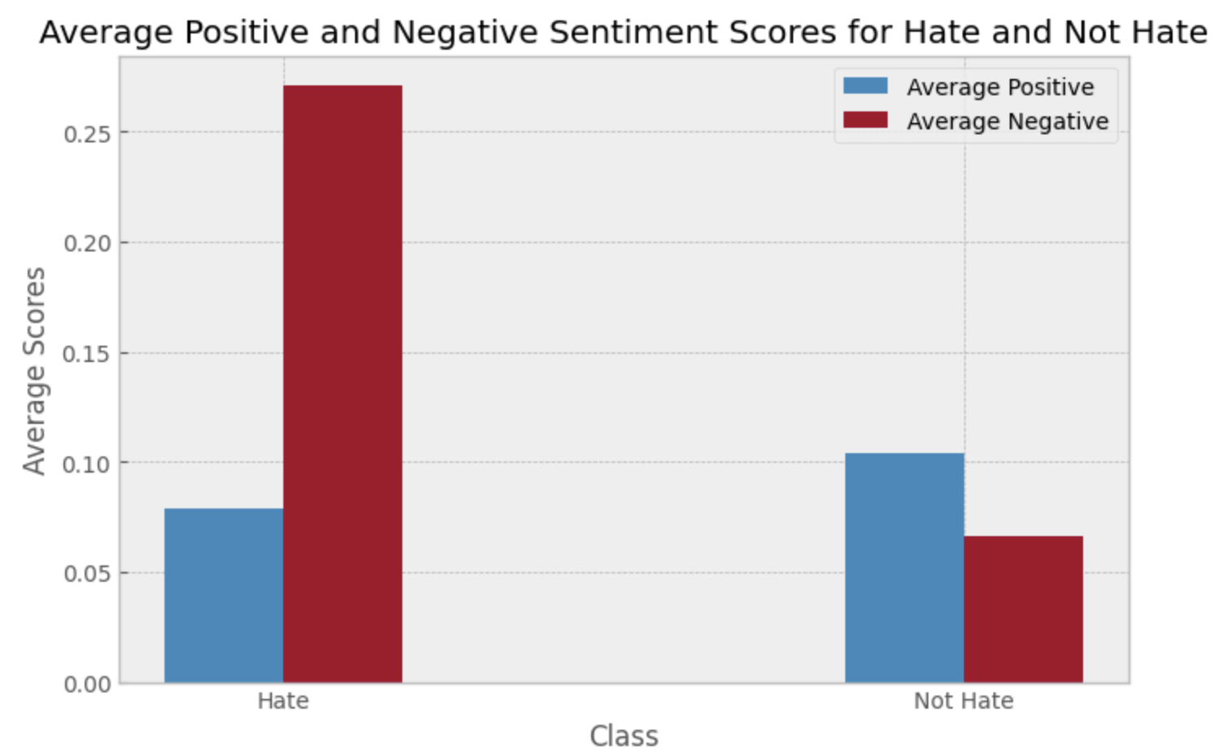
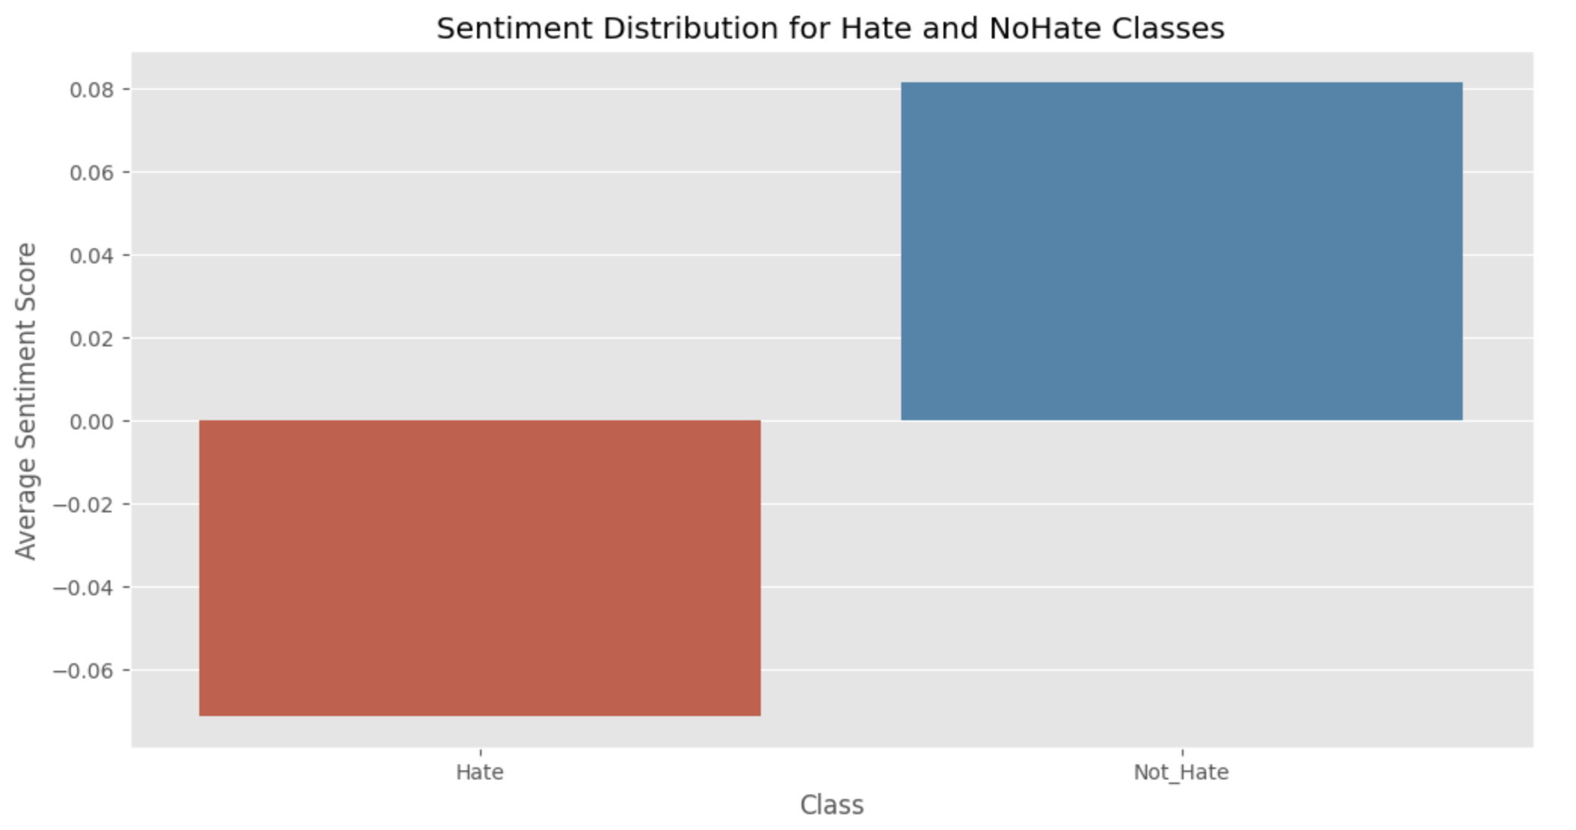
Vader Sentiment Analysis

Slide 9
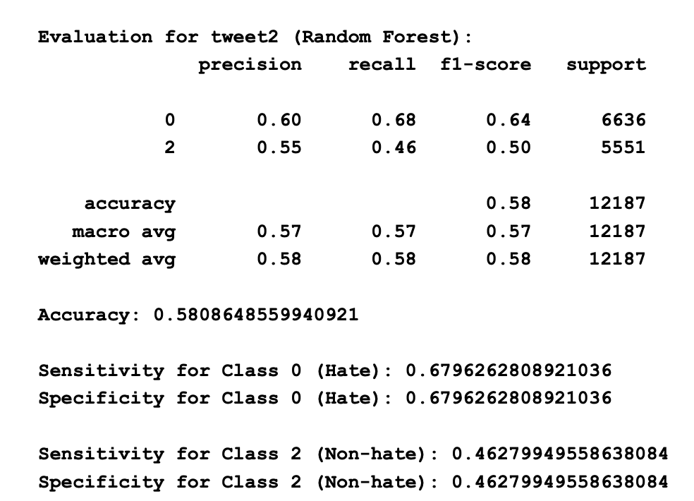
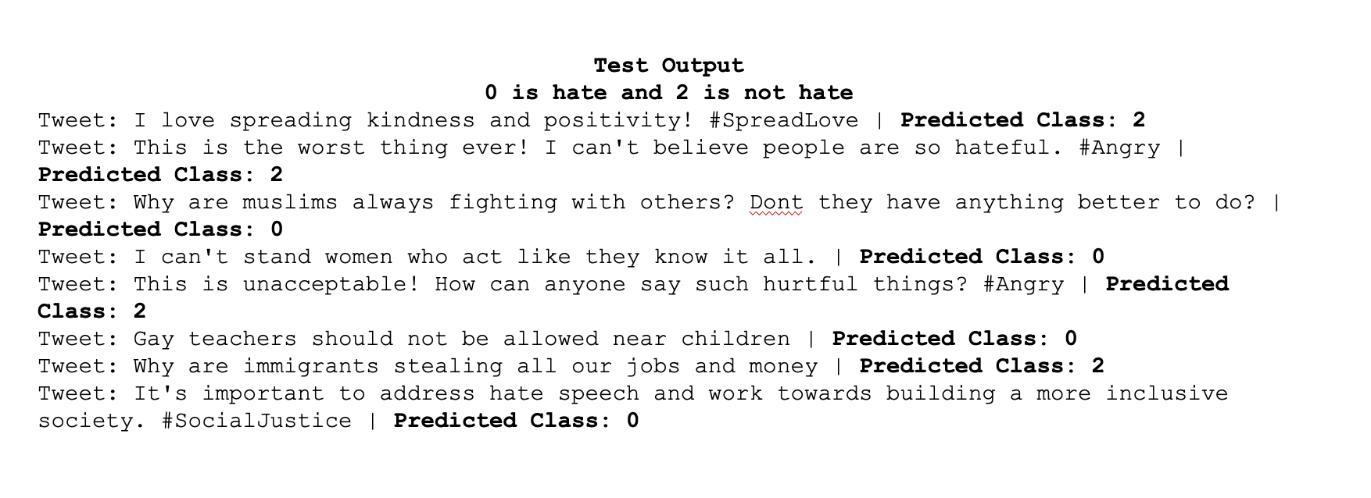
Vader Sentiment Analysis Evaluation using Random Forest

Slide 10
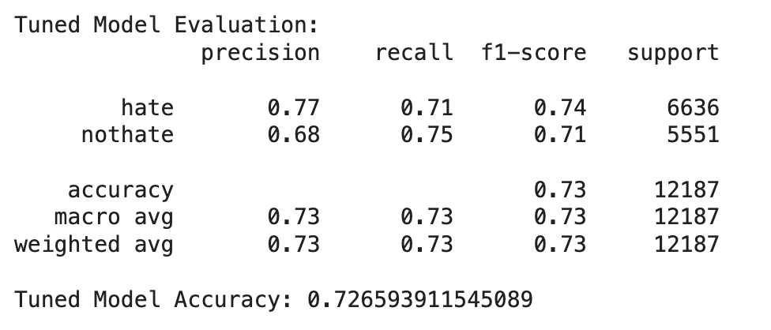
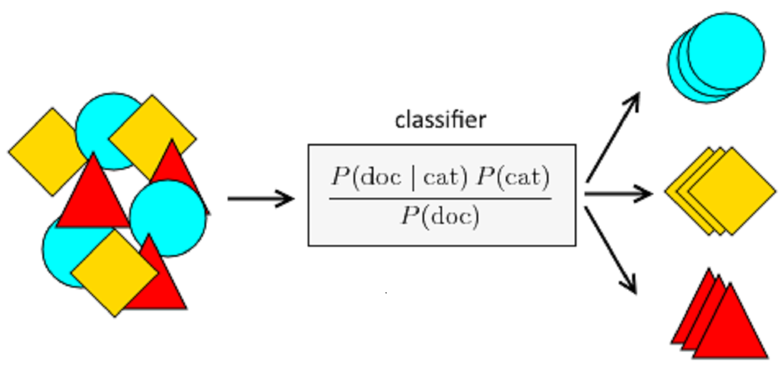
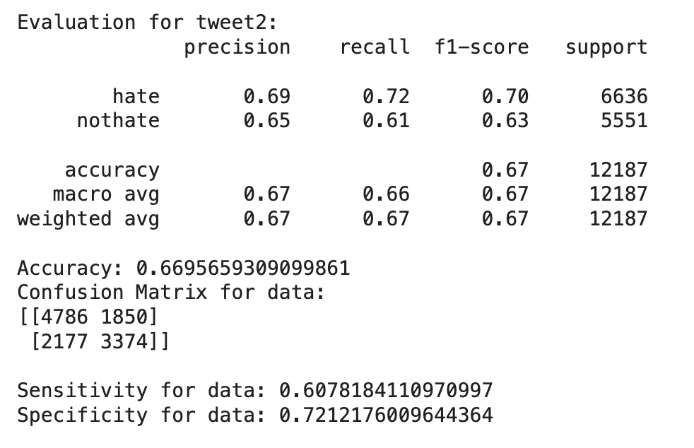
Multinomial NB Model

Slide 11

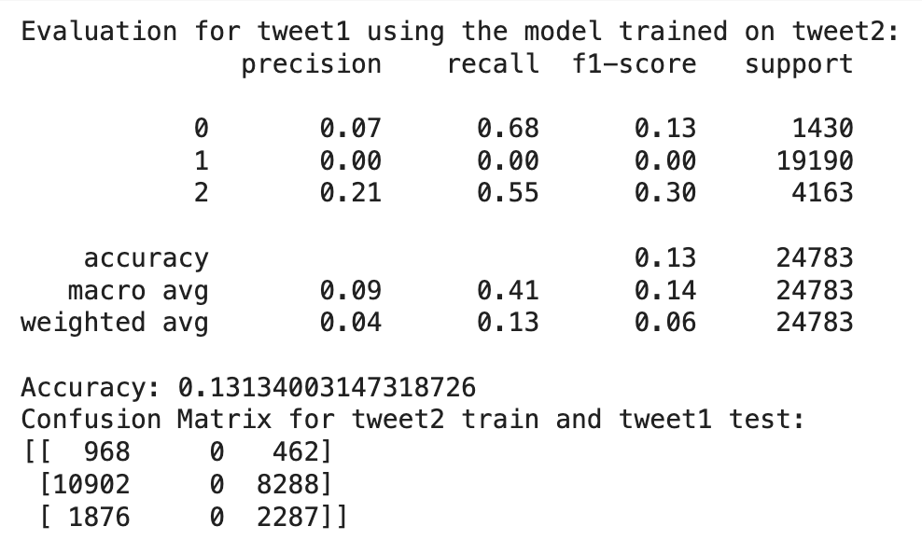

Cross Domain Evaluation

Slide 12
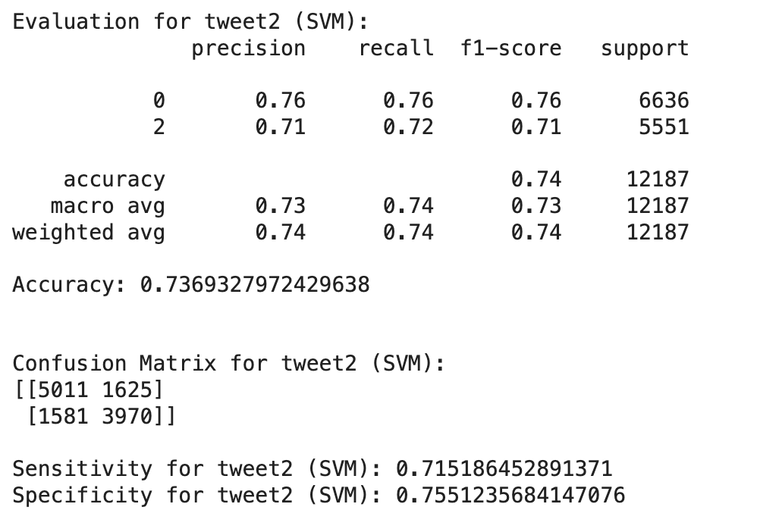
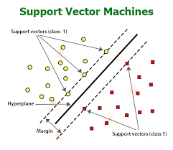
SVM

Slide 13
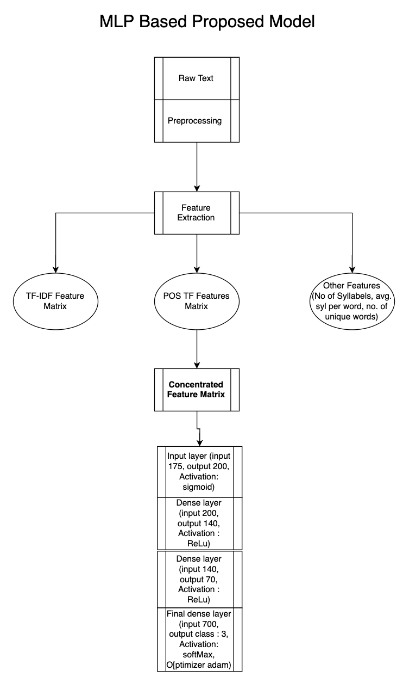
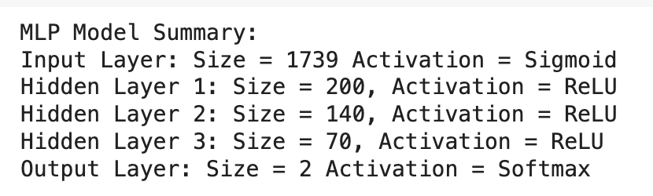
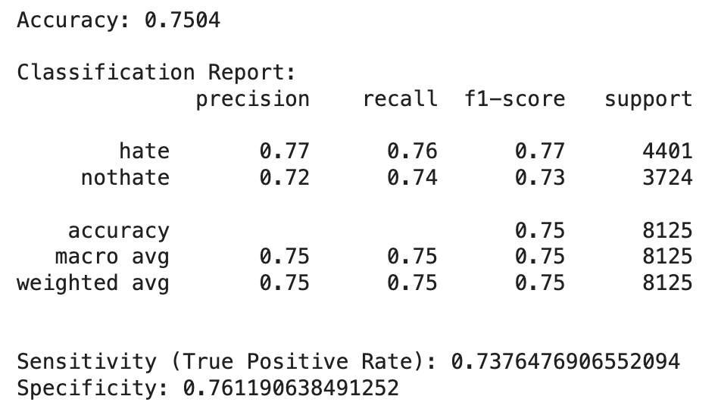
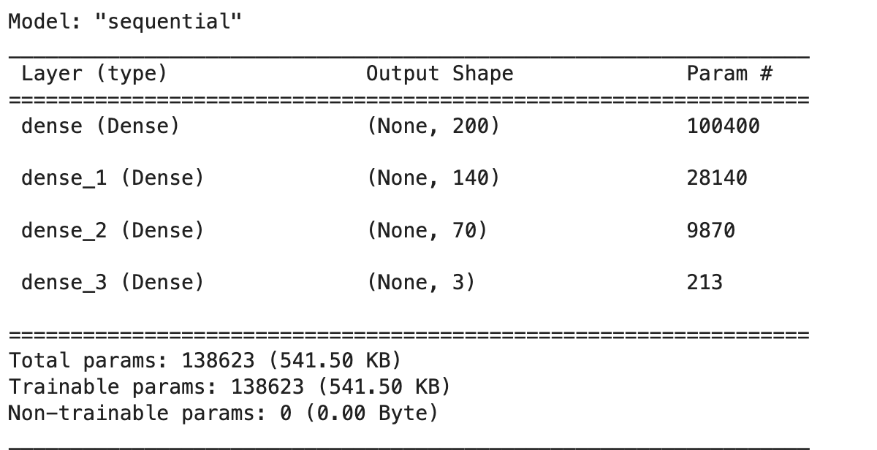
Multi-Layer Perceptron

Slide 14
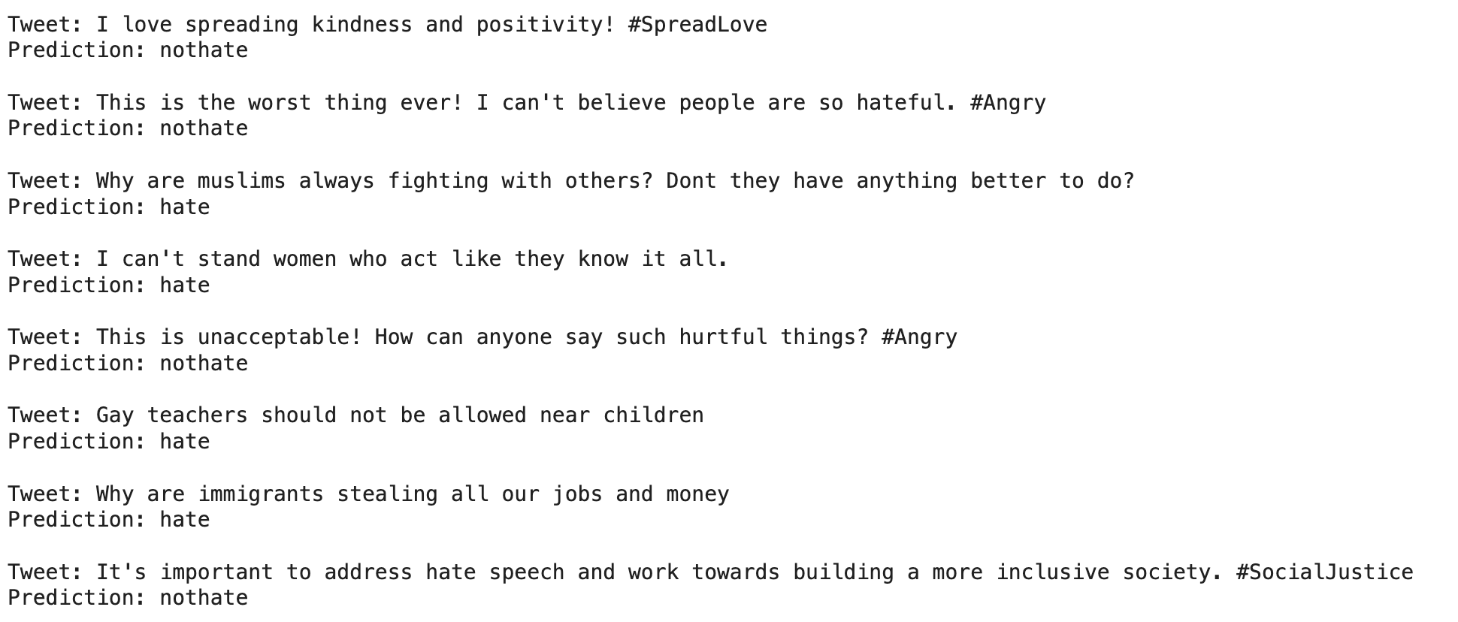
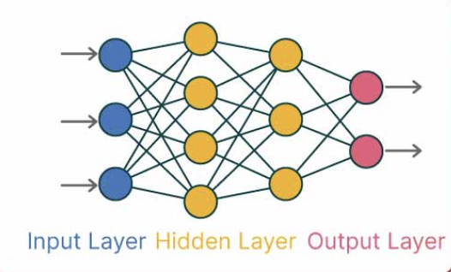
Multi-Layer Perceptron

Slide 15
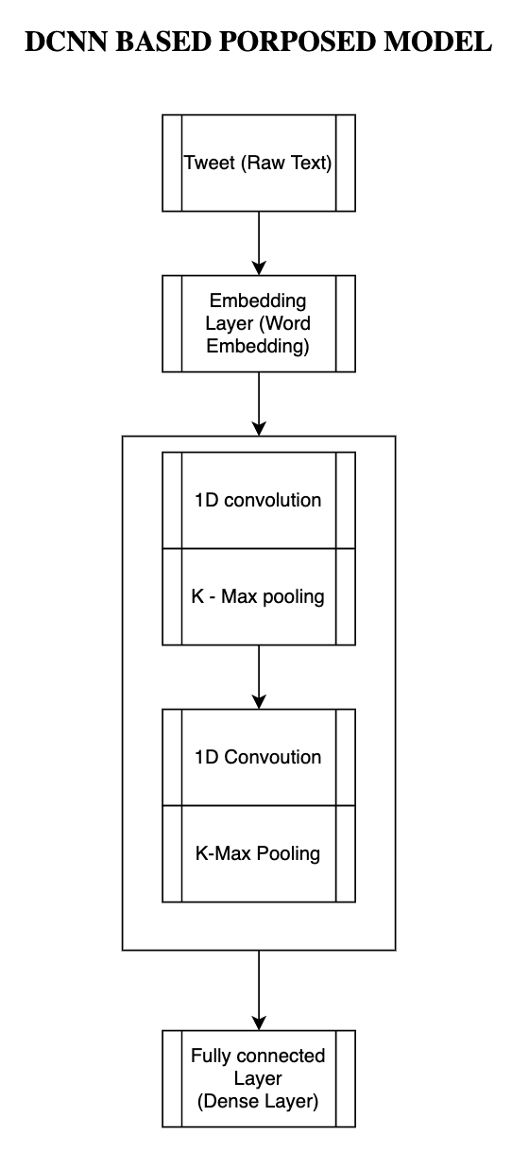
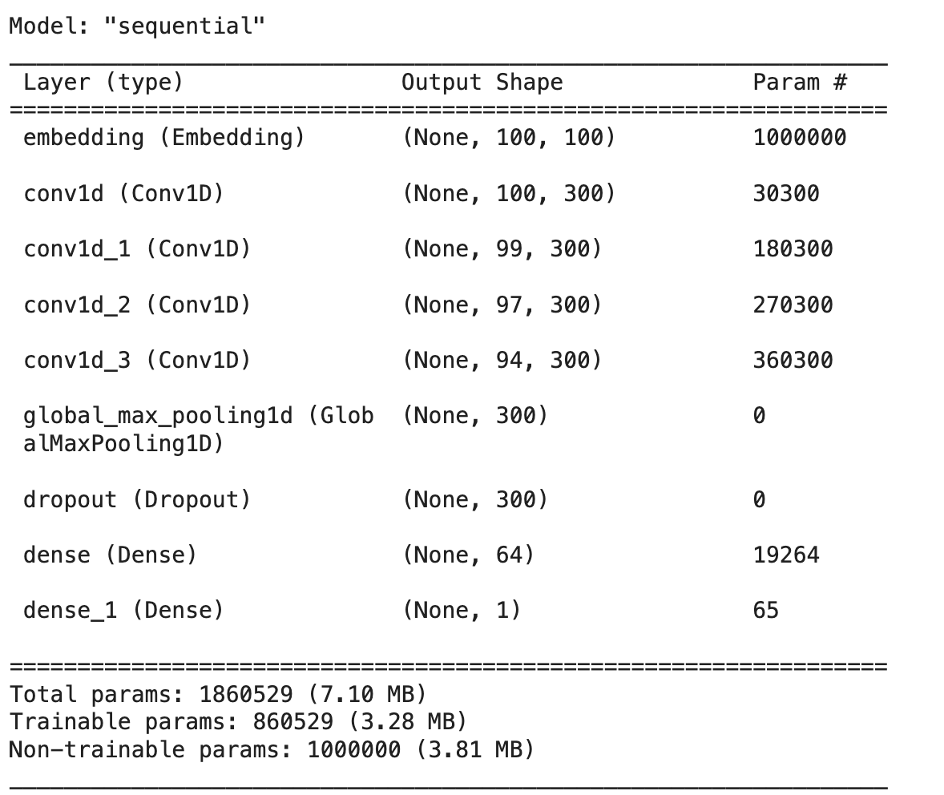
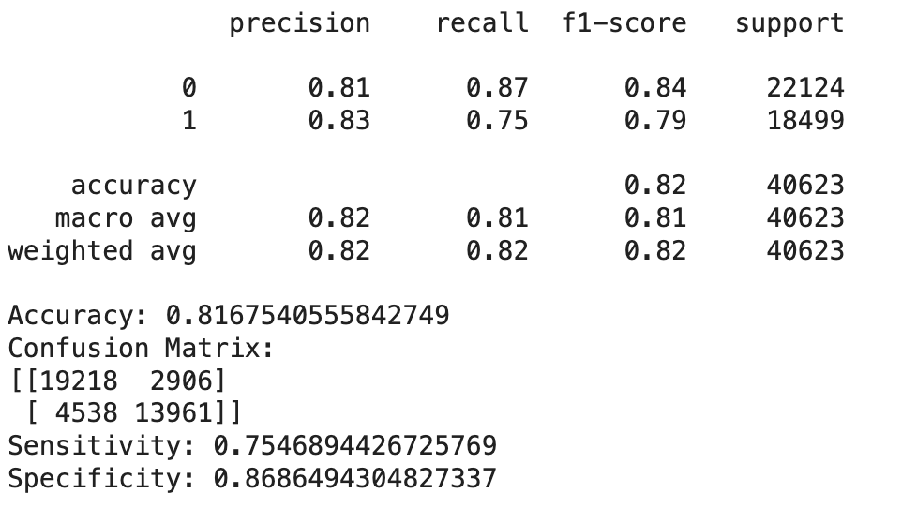
DCNN + Glove

Slide 16
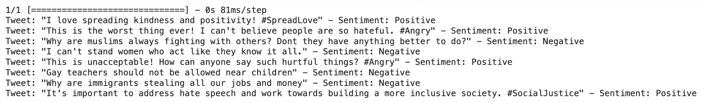
DCNN + Glove

Slide 17
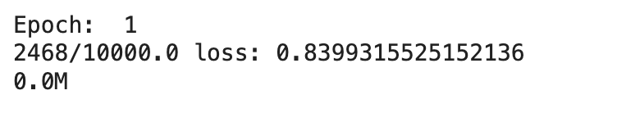
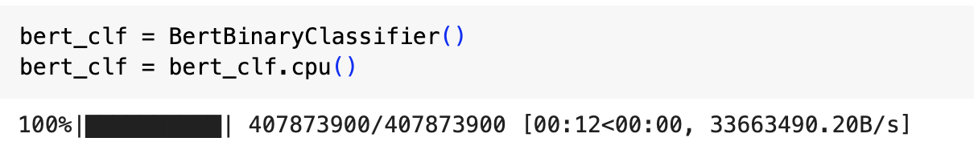
BERT

Slide 18
Ethical considerations
Freedom of speech vs Hate speech
Striking the right balance is crucial to avoid suppressing legitimate expression.
Bias & Fairness
Ensuring fairness and mitigating biases is essential to avoid discrimination and unintended consequences.
Robustness & Security
The model should not be deceived easily by users or administrators.

Slide 19
Summary
Robust Model Construction:
Prioritize the construction of models with robustness to mitigate bias.
Address concerns related to unintentional amplification of stereotypes or discriminatory behavior by users.
Real-time Monitoring Integration:
Design the model to seamlessly integrate into real-time monitoring systems.
Enable swift detection and response to potential instances of hate speech as they occur.

Slide 20

THANK YOU

